Slide 1

Introduction To Object-Oriented Programming
Chapter 2 – Variables and Data Types

Slide 2
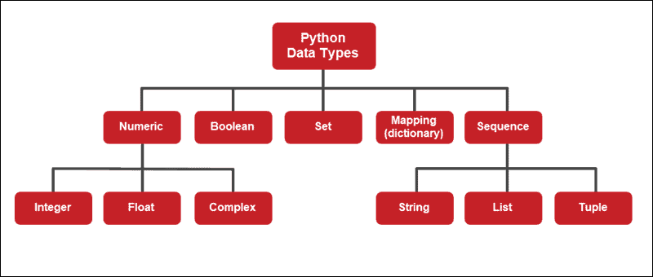
Chapter 2
In this chapter you’ll learn about the different kinds of data you can work with in your Python programs. You’ll also learn how to use variables to represent data in your programs.

Slide 3
What Really Happens When You Run hello_world.py
When you run the file hello_world.py, the ending .py indicates that the file is a Python program. Your editor then runs the file through the Python interpreter, which reads through the program and determines what each word in the program means. For example, when the interpreter sees the word print followed by parentheses, it prints to the screen whatever is inside the parentheses.
As you write your programs, your editor highlights different parts of your program in different ways. For example, it recognizes that print() is the name of a function and displays that word in one color. It recognizes that "Hello Python world!" is not Python code, and displays that phrase in a different color. This feature is called syntax highlighting and is quite useful as you start to write your own programs.

Slide 4
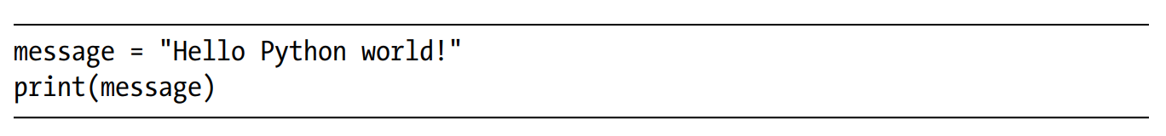
Variables
Let’s try using a variable in hello_world.py. Add a new line at the beginning of the file, and modify the second line:
Run this program to see what happens. You should see the same output you saw previously.
We’ve added a variable named message. Every variable is connected to a value, which is the information associated with that variable. In this case the value is the "Hello Python world!" text.
Adding a variable makes a little more work for the Python interpreter. When it processes the first line, it associates the variable message with the "Hello Python world!" text. When it reaches the second line, it prints the value associated with message to the screen

Slide 5
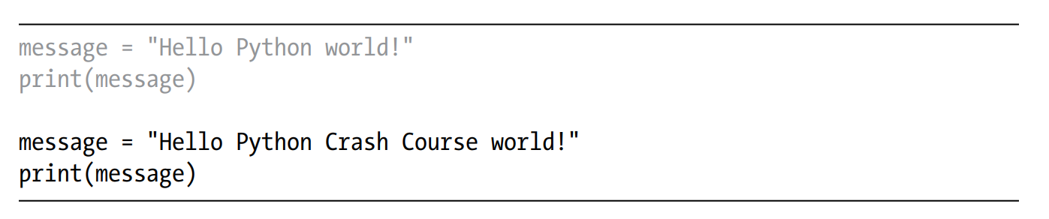
Variables
Let’s expand on this program by modifying hello_world.py to print a second message. Add a blank line to hello_world.py, and then add two new lines of code:
Now when you run hello_world.py, you should see two lines of output.
You can change the value of a variable in your program at any time, and Python will always keep track of its current value.

Slide 6
Naming and Using Variables
When you’re using variables in Python, you need to adhere to a few rules and guidelines. Breaking some of these rules will cause errors; other guidelines just help you write code that’s easier to read and understand. Be sure to keep the following rules in mind when working with variables:
- Variable names can contain only letters, numbers, and underscores. They can start with a letter or an underscore, but not with a number. For instance, you can call a variable message_1 but not 1_message.
- Spaces are not allowed in variable names, but underscores can be used to separate words in variable names. For example, greeting_message works but greeting message will cause errors.
- Avoid using Python keywords and function names as variable names. For example, do not use the word print as a variable name; Python has reserved it for a particular programmatic purpose.
- Variable names should be short but descriptive. For example, name is better than n, student_name is better than s_n, and name_length is better than length_of_persons_name.
- Be careful when using the lowercase letter l and the uppercase letter O because they could be confused with the numbers 1 and 0.

Slide 7
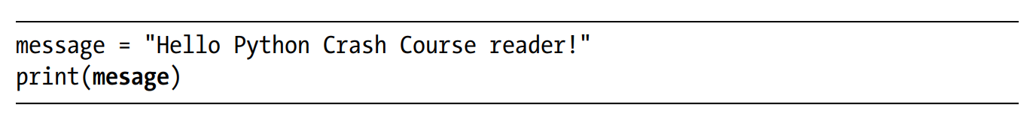
Avoiding Name Errors When Using Variables
Every programmer makes mistakes, and most make mistakes every day. Although good programmers might create errors, they also know how to respond to those errors efficiently. Let’s look at an error you’re likely to make early on and learn how to fix it.
We’ll write some code that generates an error on purpose. Enter the following code, including the misspelled word mesage, which is shown in bold:

Slide 8
Avoiding Name Errors When Using Variables
When an error occurs in your program, the Python interpreter does its best to help you figure out where the problem is. The interpreter provides a traceback when a program cannot run successfully.
A traceback is a record of where the interpreter ran into trouble when trying to execute your code.
Many programming errors are simple, single-character typos in one line of a program. If you find yourself spending a long time searching for one of these errors, know that you’re in good company. Many experienced and talented programmers spend hours hunting down these kinds of tiny errors.

Slide 9
Variables are Labels
Variables are often described as boxes you can store values in. This idea can be helpful the first few times you use a variable, but it isn’t an accurate way to describe how variables are represented internally in Python. It’s much better to think of variables as labels that you can assign to values. You can also say that a variable references a certain value.
This distinction probably won’t matter much in your initial programs, but it’s worth learning earlier rather than later. At some point, you’ll see unexpected behavior from a variable, and an accurate understanding of how variables work will help you identify what’s happening in your code

Slide 10
Data Types
In these following parts of the chapter, you will learn the most basic data types:
Strings
Numbers
Comments

Slide 11
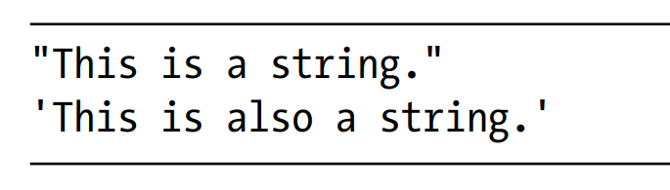
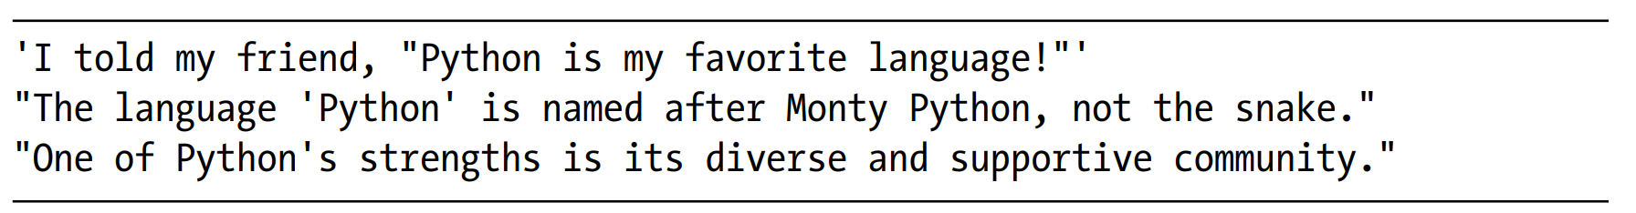
String
A string is a series of characters. Anything inside quotes is considered a string in Python, and you can use single or double quotes around your strings like this:
This flexibility allows you to use quotes and apostrophes within your strings:

Slide 12
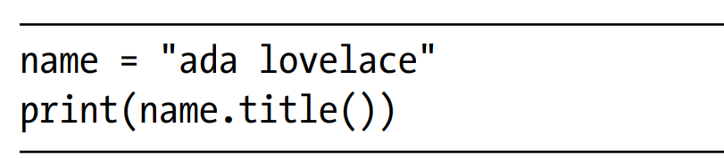
String
One of the simplest tasks you can do with strings is change the case of the words in a string. Look at the following code, and try to determine what’s happening:

Slide 13
String
In this example, the variable name refers to the lowercase string "ada lovelace". The method title() appears after the variable in the print() call.
A method is an action that Python can perform on a piece of data.
The dot (.) after name in name.title() tells Python to make the title() method act on the variable name. Every method is followed by a set of parentheses, because methods often need additional information to do their work. That information is provided inside the parentheses.
The title() function doesn’t need any additional information, so its parentheses are empty

Slide 14
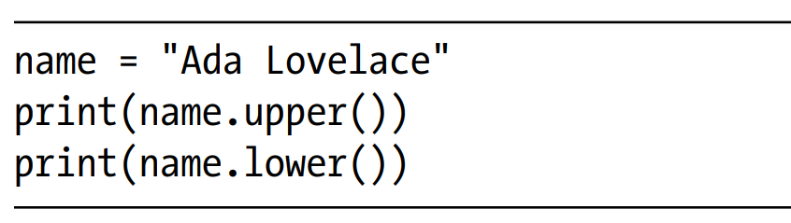
String
Several other useful methods are available for dealing with case as well.
For example, you can change a string to all uppercase or all lowercase letters like this:

Slide 15
String
The lower() method is particularly useful for storing data. You typically won’t want to trust the capitalization that your users provide, so you’ll convert strings to lowercase before storing them.
Then when you want to display the information, you’ll use the case that makes the most sense for each string.

Slide 16
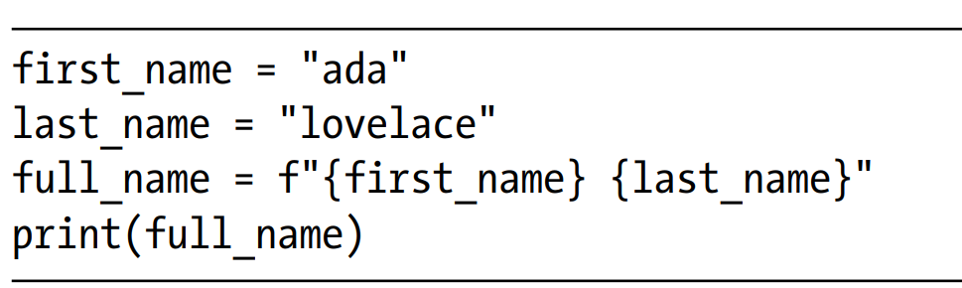
Using Variables in Strings
In some situations, you’ll want to use a variable’s value inside a string. For example, you might want to use two variables to represent a first name and a last name, respectively, and then combine those values to display someone’s full name:

Slide 17
Using Variables in Strings
To insert a variable’s value into a string, place the letter f immediately before the opening quotation mark. Put braces around the name or names of any variable you want to use inside the string. Python will replace each variable with its value when the string is displayed.
These strings are called f-strings. The f is for format, because Python formats the string by replacing the name of any variable in braces with its value.

Slide 18
Adding Whitespace to Strings with Tabs or Newlines
In programming, whitespace refers to any nonprinting characters, such as spaces, tabs, and end-of-line symbols. You can use whitespace to organize your output so it’s easier for users to read.
To add a tab to your text, use the character combination \t
To add a newline in a string, use the character combination \n
You can also combine tabs and newlines in a single string. The string "\n\t" tells Python to move to a new line, and start the next line with a tab.

Slide 19
Stripping Whitespace
Extra whitespace can be confusing in your programs. To programmers, 'python' and 'python ' look pretty much the same. But to a program, they are two different strings. Python detects the extra space in 'python ' and considers it significant unless you tell it otherwise.
It’s important to think about whitespace, because often you’ll want to compare two strings to determine whether they are the same
Python can look for extra whitespace on the right and left sides of a string. To ensure that no whitespace exists at the right side of a string, use the rstrip() method. For the left side of a string, use lstrip() instead.

Slide 20
Removing Prefixes
When working with strings, another common task is to remove a prefix.
Enter the name of the variable followed by a dot, and then the method removeprefix(). Inside the parentheses, enter the prefix you want to remove from the original string
Like the methods for removing whitespace, removeprefix() leaves the original string unchanged. If you want to keep the new value with the prefix removed, either reassign it to the original variable or assign it to a new variable

Slide 21
Avoiding Syntax Errors with Strings
One kind of error that you might see with some regularity is a syntax error.
A syntax error occurs when Python doesn’t recognize a section of your program as valid Python code.
For example, if you use an apostrophe within single quotes, you’ll produce an error. This happens because Python interprets everything between the first single quote and the apostrophe as a string. It then tries to interpret the rest of the text as Python code, which causes errors.

Slide 22
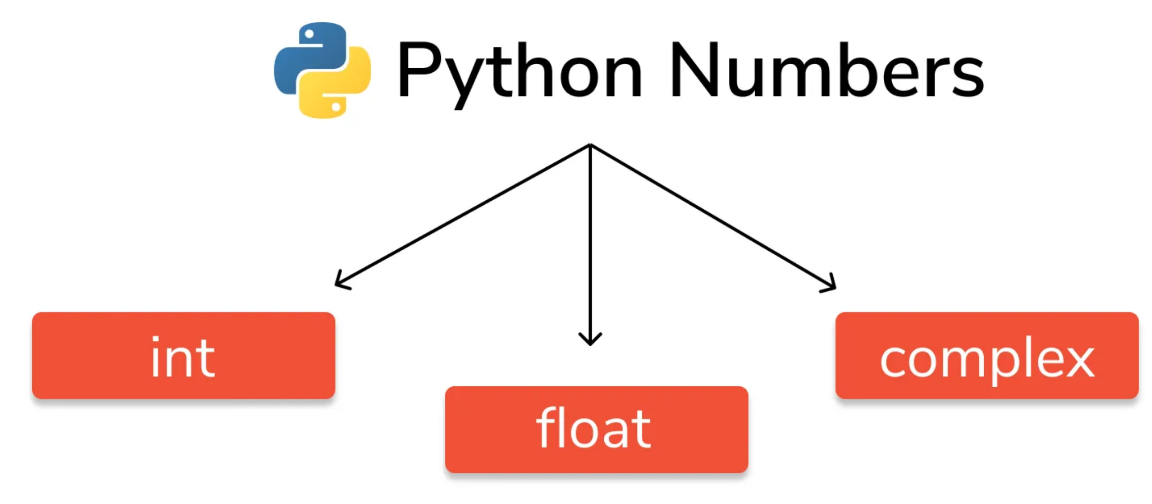
Numbers
Numbers are used quite often in programming to keep score in games, represent data in visualizations, store information in web applications, and so on.
Python treats numbers in several different ways, depending on how they’re being used.

Slide 23
Integers
You can add (+), subtract (-), multiply (*), and divide (/) integers (whole numbers) in Python.
Python supports the order of operations too, so you can use multiple operations in one expression. You can also use parentheses to modify the order of operations so Python can evaluate your expression in the order you specify.

Slide 24
Floats
Python calls any number with a decimal point a float. This term is used in most programming languages, and it refers to the fact that a decimal point can appear at any position in a number.
Every programming language must be carefully designed to properly manage decimal numbers so numbers behave appropriately, no matter where the decimal point appears.

Slide 25
Integers and Floats
When you divide any two numbers, even if they are integers that result in a whole number, you’ll always get a float.
If you mix an integer and a float in any other operation, you’ll get a float as well. Python defaults to a float in any operation that uses a float, even if the output is a whole number.

Slide 26
Multiple Assignment
You can assign values to more than one variable using just a single line of code. This can help shorten your programs and make them easier to read
You’ll use this technique most often when initializing a set of numbers.
You need to separate the variable names with commas, and do the same with the values, and Python will assign each value to its respective variable. As long as the number of values matches the number of variables, Python will match them up correctly.

Slide 27
Constants
A constant is a variable whose value stays the same throughout the life of a program. Python doesn’t have built-in constant types, but Python programmers use all capital letters to indicate a variable should be treated as a constant and never be changed.
When you want to treat a variable as a constant in your code, write the name of the variable in all capital letters.

Slide 28
Comments
Comments are an extremely useful feature in most programming languages. Everything you’ve written in your programs so far is Python code.
As your programs become longer and more complicated, you should add notes within your programs that describe your overall approach to the problem you’re solving.
A comment allows you to write notes in your spoken language, within your programs.
In Python, the hash mark (#) indicates a comment. Anything following a hash mark in your code is ignored by the Python interpreter.

